Slide 1
DATA 601
Concluding Remarks
UMBC Data 601
Instructor: Felix Gonzalez
fgonzale@umbc.edu

Slide 2
What is Data Science?
Artificial
Intelligence (AI)
Data Science
Data Analytics
Machine
Learning (ML)
Natural Language Processing (NLP
Statistics
Deep Learning (DL)
Generative AI

Slide 3
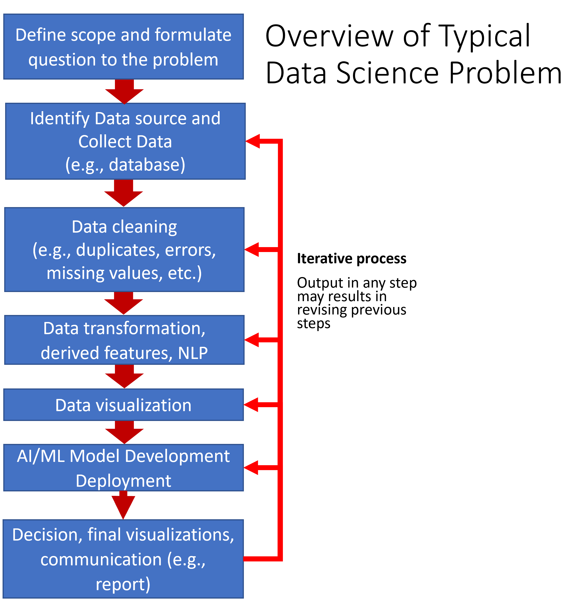
Data Science Process
Notes:
Many of the terms in this slide are often used interchangeably, their definitions can vary from various data analytic and data science commercial tools and frameworks and have various levels of overlap. We will talk about these during the class.

Slide 4
Future Reading

Slide 5
Tools and Platforms
Tools often have a combination of capabilities (e.g., visualization, AI, ML, NLP, etc.). Examples of readily available tools:
  Open source (e.g., Python, R, Jupyter, JSD3, etc.)
Example of data analytics and data science platforms all with different capabilities, limitations, and learning curves:
  Anaconda (Data science distribution package Python/R/Jupyter)
  NVIDIA Deep Learning Institute (DLI)/Data Science Libraries (e.g., RAPIDS)/Omniverse
  Google Cloud Services Platform
  Amazon Web Services
  MicroStrategy
  MS Power Apps/Power Bi/Azure
  Tableau
  Hadoop
  Palantir Foundry
  SkySpark
  PNNL Inspire (text analysis)
  Low code or no-code development platforms
Jargon can vary from company to company from tools to tools.

Slide 6
Platform Specific Training and Certifications
Microsoft Certifications:
  https://learn.microsoft.com/en-us/credentials/browse/
AWS Certifications:
  https://aws.amazon.com/certification/
  AWS paths: https://d1.awsstatic.com/training-and-certification/docs/AWS_certification_paths.pdf?pp=cert&c=exam&z=6
NVIDIA:
  Deep Learning Institute: https://www.nvidia.com/en-us/training/
  NVIDIA GTC Conference: https://www.nvidia.com/gtc/
Felix’s Table of Certifications and Notes
  https://docs.google.com/spreadsheets/d/1e8vvSrtGjtrkO5OrNAR8QYaCeowtCTX2/edit?usp=drive_link&ouid=103437557434463890960&rtpof=true&sd=true

Slide 7
Approaches and Datasets Resources
Title | Description | Link | Comment
Github | Used by many developers to share code and collaborate. | https://github.com/ | Class code is hosted in this website.
Kaggle | Host data science competitions, datasets, Jupyter notebooks, etc. | https://www.kaggle.com/ | Good source for datasets and Jupyter Notebooks.
Google Research Data | Google Dataset Search Engine | https://datasetsearch.research.google.com/ | Search engine for datasets. May send you to data in other websites.
Medium and Towards Data Science | Short articles on data science, data analysis, AI, ML, NLP, and other related topics. | https://medium.com and https://towardsdatascience.com | Articles are not peer reviewed.
Conference Papers and Peer Reviewed Journals | Peer reviewed journals on data science, data analysis, AI, ML, NLP and other related topics | No specific recommendation as recommendation may vary by topic. | Most authoritative source of information along with published books.

Slide 8
Visualization Examples Resources
Title | Description | Link | Comments
MatPlotLib Example Gallery | Python Plotting Library | https://matplotlib.org/stable/gallery/index.html | Library included in Anaconda.
Seaborn Example Gallery | Python Plotting Library | https://seaborn.pydata.org/examples/index.html | Library included in Anaconda.
Anaconda Panel App Gallery | Anaconda Panel Dashboard Examples | https://panel.holoviz.org/gallery/index.html | Library included in Anaconda.
Bokeh Gallery | Bokeh Dashboard Examples | https://docs.bokeh.org/en/latest/docs/gallery.html | Library included in Anaconda.
Plotly Example Gallery | Python Plotting Library | https://plotly.com/python/ | Library included in Anaconda.
D3.JS | Data Driven Documents Visualization Library | https://d3-graph-gallery.com/ | Used to deploy dynamic website plots.
Five Thirty Eight | Interactive Dashboard Examples | https://projects.fivethirtyeight.com/ | Excellent Website that provides great examples on the capabilities of dashboards and data analytic visualizations.

Slide 9
Important Topics
Data processes:
  Collection
  Data cleaning, preparation, wrangling, transformation, processing, pipeline
Working with data
  Various types of data (e.g., integers, floats, text, dates, categorical)
  Various types of data collections (e.g., lists, arrays, dictionaries, data frames)
  Data augmentation, synthetic data, data pipelines, algorithm and data bias, data balance
Exploratory data analysis, data visualization, and statistics
Time series
Machine Learning (ML)
Supervised ML (e.g., train, test, split, sampling, fitting, predicting)
  Regression
  Classification (e.g., binary, multi-class, multi-label)
Unsupervised ML Clustering (e.g., kmeans, DBSCAN)
Model performance evaluation, metrics and related topics:
  Feature selection
  Model underfitting and overfitting
  Accuracy, precision, recall, F1 score, confusion matrix
Natural language processing (e.g., text normalization, similarity ranking, text classification, text clustering)
Dashboarding and user interface design
Ethics (e.g., fairness, security, privacy, civil rights)
Communication of results

Slide 10
Other Topics
Model optimization and hyperparameter tunning
Censored Data and ML
Version control and environment freezing
Deployment (e.g., in cloud service, docker and containers)
Dimensionality reduction (e.g., PCA, TSNE, UMAP)
Ensemble Learning: merging prediction from multiple models including but not limited to ensemble models, bagging, boosting, stacking)
Deep learning (e.g., transformers)
Reinforcement learning
Other Natural Language Processing (NLP) approaches:
  Latent Dirichlet Allocation (LDA)
  Word embeddings text models
  Named entity recognition
  Text sentiment analysis
  Text summarization methods and models
  Generative AI and large language models
Knowledge Graphs and Network Analysis

Slide 11
Thank You!!!

